Slide 1
AIH Management
Bita Sepehri MD
Assistant professor of Gastroenterology and Hepatology
Tabriz university of medical science

Slide 2
Chronic hepatitis characterized by immunologic and autoimmune features, generally including the presence of circulating autoantibodies and a high serum gamma globulin concentration

Slide 3
Type 1, or classic autoimmune hepatitis, is characterized by circulating ANA and/or ASMA antibodies
Adults & adolescents
Type 2 autoimmune hepatitis is defined by the presence of antibodies to liver/kidney microsomes (ALKM-1) and/or to a liver cytosol antigen (ALC-1)
Young Women , infants , girls

Slide 4
INDICATIONS FOR TREATMENT
The decision to treat … is based on the severity of symptoms, the magnitude of the serum aminotransferase and gamma globulin elevations, histologic findings, and the potential for side effects

Slide 5
Serum aminotransferase levels greater than 10-fold the upper limit of normal
Serum gamma globulin level greater than twice the upper limit of normal
Serum aminotransferase levels greater than twice the upper limit of normal along with:
Symptoms
An elevated gamma globulin level, even if less than twice the upper limit of normal
An elevated conjugated bilirubin level
Interface hepatitis on biopsy
Histologic features of bridging necrosis or multiacinar necrosis
Cirrhosis with any degree of inflammation on biopsy
Children

Slide 6
Treatment may not be required in asymptomatic patients with normal or near-normal serum aminotransferase and gamma globulin levels who have minimal necroinflammatory activity on liver biopsy (relatively low risk of disease progression)
Treatment is not recommended for patients with cirrhosis and inactive disease (characterized by the absence of inflammatory cells on liver biopsy and normal or near-normal serum aminotransferases)

Slide 7
it is reasonable ……treatment to a patient with histologic evidence of interface hepatitis without bridging necrosis or multiacinar necrosis, particularly if the patient is young (age less than 50 years)
Patients who are not treated should be monitored for signs of disease progression
If symptoms develop, if the aminotransferase or gamma globulin levels increase, or if histologic evidence of active disease is seen on follow-up biopsies, treatment should be reconsidered

Slide 8
GENERAL APPROACH TO TREATMENT
Begin treatment with glucocorticoid monotherapy (prednisone or prednisolone followed by a taper) in most patients
For patients with mild disease (eg, asx patients with aminotransferase levels <10 times the ULN), lower-dose prednisone monotherapy (eg, 20 mg per day) is an alternative

Slide 9
Moderate to severe disease who are at increased risk for side effects from glucocorticoids (eg, those with brittle diabetes, osteoporosis, emotional lability, a history of psychosis, or poorly controlled hypertension …. a combination of lower-dose prednisone (30 mg per day) and azathioprine (50 mg per day) for initial treatment
For patients at high risk for glucocorticoid side effects, combination therapy ….of lower doses of prednisone
Budesonide …alternative to prednisone in these patients, though long-term data on safety and efficacy are lacking

Slide 10
Response to induction therapy
●Remission – Approximately 65 to 80 percent
●Incomplete response to therapy – Approximately 13 percent
●Failure to respond to treatment – Approximately 10 percent
some patients (10 percent) develop side effects from treatment that require discontinuation of a particular therapy.

Slide 11
Remission
Resolution of symptoms
Normalization of serum aminotransferase levels
Normalization of serum bilirubin and gamma globulin levels
Improvement in liver histology to normal or only mild portal hepatitis (or minimal to no activity in patients with cirrhosis)

Slide 12
Incomplete response to treatment
Some or no improvement in clinical, laboratory, and histologic features despite compliance with treatment for two to three years
No worsening of the condition

Slide 13
Treatment failure
10 percent …have clinical and laboratory deterioration despite adherence to conventional treatment
Sustained biochemical and histologic activity leading to the development or worsening of cirrhosis with eventual complications and death
The need for liver transplantation

Slide 14
Treatment failure is more frequent in three groups of patients
Those with established cirrhosis
Those who develop disease at a younger age or have had a longer duration of disease before treatment
Those with HLA-B8 and/or HLA-DR3 phenotypes

Slide 15
SUBSEQUENT MANAGEMENT

Slide 16
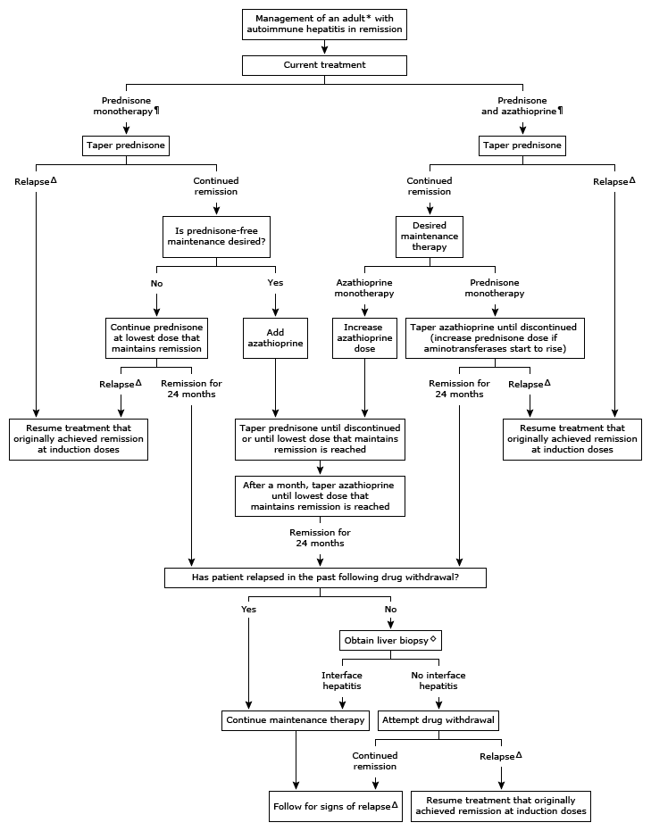

Slide 17
Patients with an incomplete response to treatment
The first step in assessing a patient with an incomplete response to treatment is to confirm adherence to the therapeutic regimen
In patients on glucocorticoid monotherapy, azathioprine (50 mg daily) can be added
In patients taking combination therapy with glucocorticoids and azathioprine, the dose of azathioprine can be increased to 2 mg/kg daily (to a maximum of 200 mg daily

Slide 18
INVESTIGATIONAL TREATMENTS
Alternative treatments such as mycophenolate mofetil, budesonide, cyclosporine, tacrolimus, and sirolimus …. for the patients who fail to respond to conventional treatment or to provide treatment options that minimize or avoid glucocorticoid side effects

Slide 19
SPECIAL CIRCUMSTANCES AND POPULATIONS
Patients with fulminant hepatitis and acute liver failure
Children
Pregnant
Patients with cirrhosis
Patients with coexisting hepatitis C virus infection
Patients with variant forms of autoimmune hepatitis (eg, overlapping autoimmune hepatitis and primary biliary cirrhosis)

Slide 20
FHF _Glucocorticoids are of little benefit in fulminant autoimmune hepatitis and may favor septic complications
Children — Autoimmune hepatitis tends to be more severe in children compared with adults. Therefore, treatment is usually recommended at the time of diagnosis for all children, regardless of the degree of laboratory test or biopsy abnormalities

Slide 21
Pregnancy _Usual treatment consists of glucocorticoids and/or azathioprine, both of which appear to be safe during pregnancy, though azathioprine is listed as pregnancy class D
Pregnancy in women with autoimmune hepatitis has been associated with an increased risk of prematurity, low birth weight, and fetal loss

Slide 22
Cirrhosis is common in patients with AIH, with some patients requiring LT

Slide 23
Risk of cirrhosis
Up to 30 % of adult patients and almost one-half of pediatric patients will have cirrhosis at the time of diagnosis, and cirrhosis develops in another 30 to 50 percent of patients during follow-up

